Slide 1
Pt.1 General System Design

Slide 2
Pt.1.1 Plan A——Full STM32
供电模块
OpenMV
电机模块
STM32
传感器
IMU
超声波

Slide 3
Pt.1.2 Plan B——Raspberry Pi 4B + STM32
供电模块1
电机模块
STM32
超声波
供电模块2
树莓派4B
IMU
WIFI
相机
PC

Slide 4
Pt.1.3 Plan C——STM32 + Remote Computation
供电模块
超声波
电机模块
STM32
传感器
IMU
OpenMV
PC
WIFI

Slide 5
Pt.1 Summary
Current Plan: [Plan B Pro]
供电模块1
电机模块
STM32
供电模块2
树莓派4B
IMU
WIFI
相机
PC

Slide 6
Pt.2 Specific Module Design (Plan A)
(Note that the difference between Plan B and Plan A can be nearly ignored, hence modification will be completed in the electrical system schematics)

Slide 7
Pt.2.1 Sensor Module
供电模块
OpenMV
电机模块
STM32
传感器
IMU
超声波

Slide 8
Pt.2.1 Sensor Module
供电模块
OpenMV
电机模块
STM32
传感器
IMU
超声波
Module | Communication | Power | Model | Amount
OpenMV | GPIO x2 | 5V | / | 1
IMU | I2C x2 | 3.3-5V | / | 1
ultrasonic | GPIO x2 | 5V | HC-SR04 | 2

Slide 9
Pt.2.1 Sensor Module
OpenMV
GPIO
STM32
IMU
供电模块
超声波

Slide 10
Pt.2.2 Motor Module
供电模块
OpenMV
电机模块
STM32
传感器
IMU
超声波

Slide 11
Pt.2.2 Motor Module
供电模块
OpenMV
电机模块
STM32
传感器
IMU
超声波
Module | Control | Power | Model | Amount
DC motor (wheel) | GPIO x5 | 12V | / | 2
DC motor (gripper) | GPIO x5 | 12V | / | 1
servo motor | GPIO x1 | 5V | / | 1

Slide 12
Pt.2.2 Motor Module
STM32
供电模块
GPIO (PWM+IO)
电机模块
电机驱动板
12V

Slide 13
Pt.2.3 Power Module
供电模块
OpenMV
电机模块
STM32
传感器
IMU
超声波

Slide 14
Pt.2.3 Power Module
供电模块
OpenMV
电机模块
STM32
传感器
IMU
超声波
Module | Power Input | Power Output | Model | Amount
Li-ion battery | / | 12V (output) | / | 1
power module | 12V | 1.25V + 3.3V + 5V (x5) | / | 1
motor driver board | 12V + 3.3V / 5V | / | / | 1

Slide 15
Pt.2.3 Power Module
舵机
5V
供电模块
3.3V + 5V
STM32 + 传感器
12V
锂电池
12V
电机驱动板

Slide 16
Pt.2 Specific Module Design (Plan B)

Slide 17
Appendix

Slide 18
A.1 Technical Norms

Slide 19
A.1.1 3D-model Coloring Norms
Material | Color
PVC | White (Default)
TPU95 | Blue
TPU85 | Green
motor | Red
PLA | Orange
electronics | (Original)

Slide 20
A.1.2 Schematic Norms
Line Type | Color | Width
Normal (e.g. Communication) | Black (Default) | 0.75
GND | Grey | 1
VCC | Red | 1
Negative Electrode | Grey | 1
PWM | Green | 1
Encoder Feedback | Blue | 1

Slide 21
A.2 Documentations of Electronic Components

Slide 22
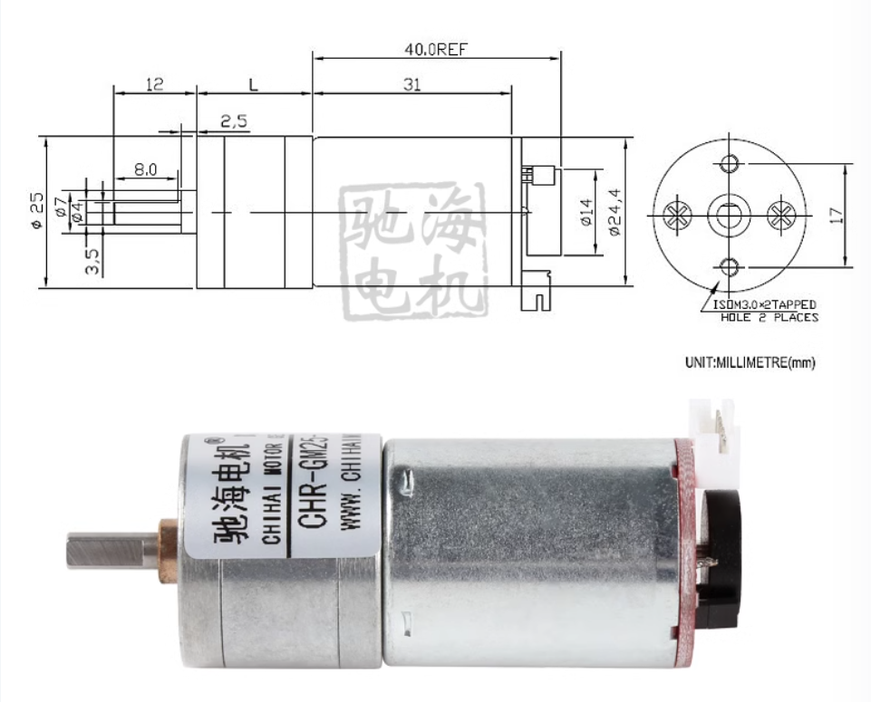
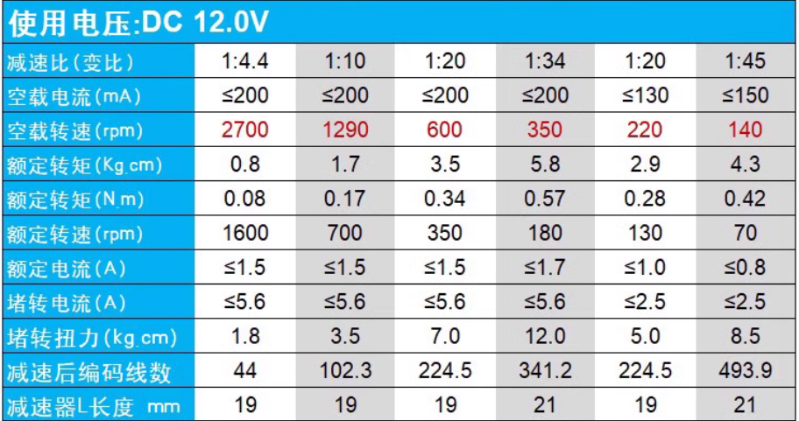
A.2.1 DC Motor
型号：25GA370
电压：12V
减速比：1：34 (350转)
质量：≈100g
淘宝链接1
淘宝链接2（Official）
TT马达

Slide 23
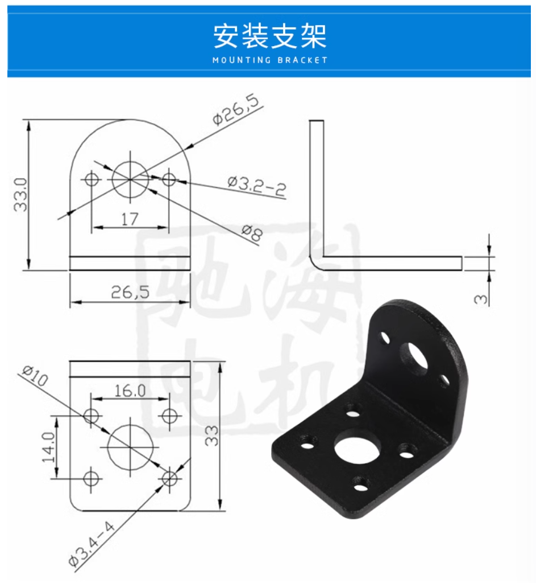
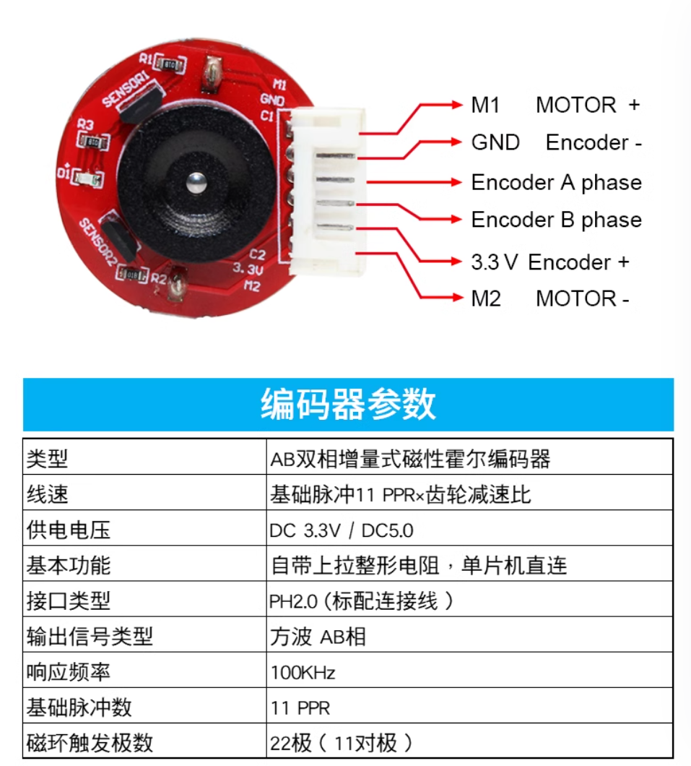
A.2.1 DC Motor

Slide 24
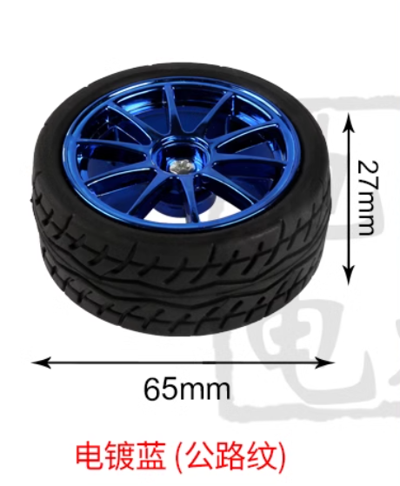
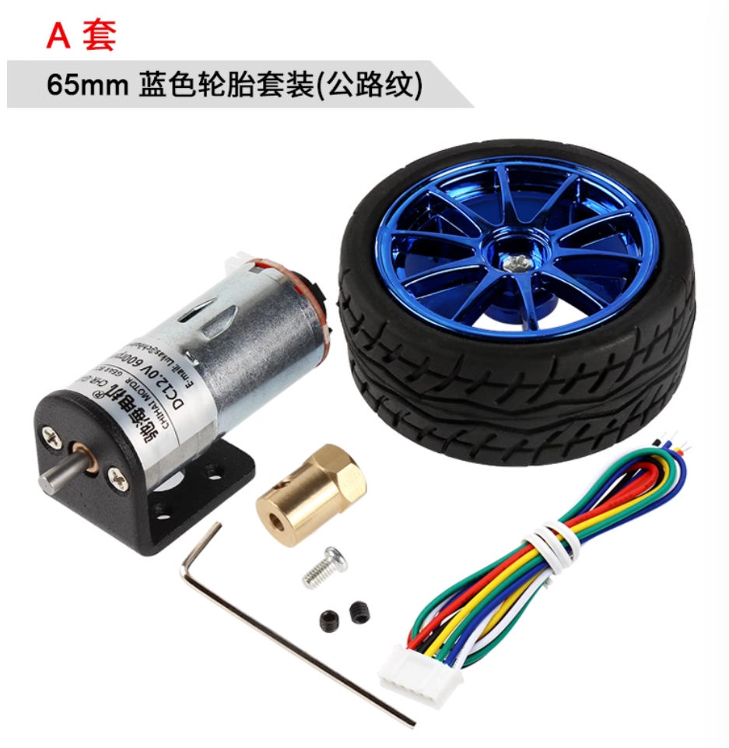
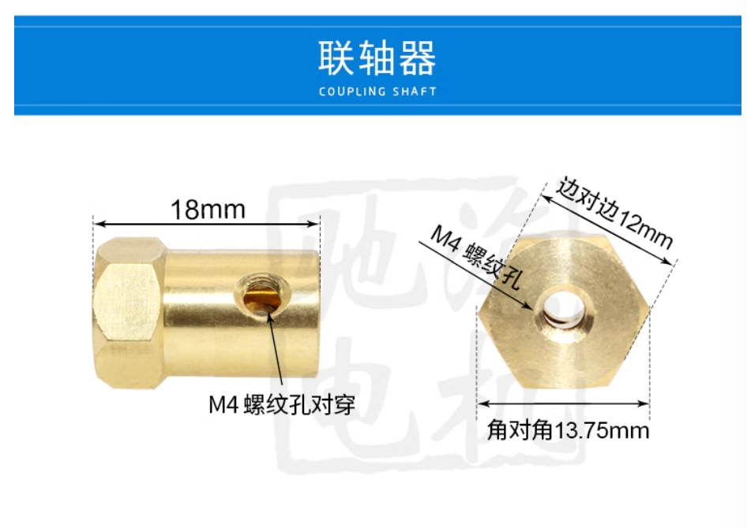
A.2.1 DC Motor

Slide 25
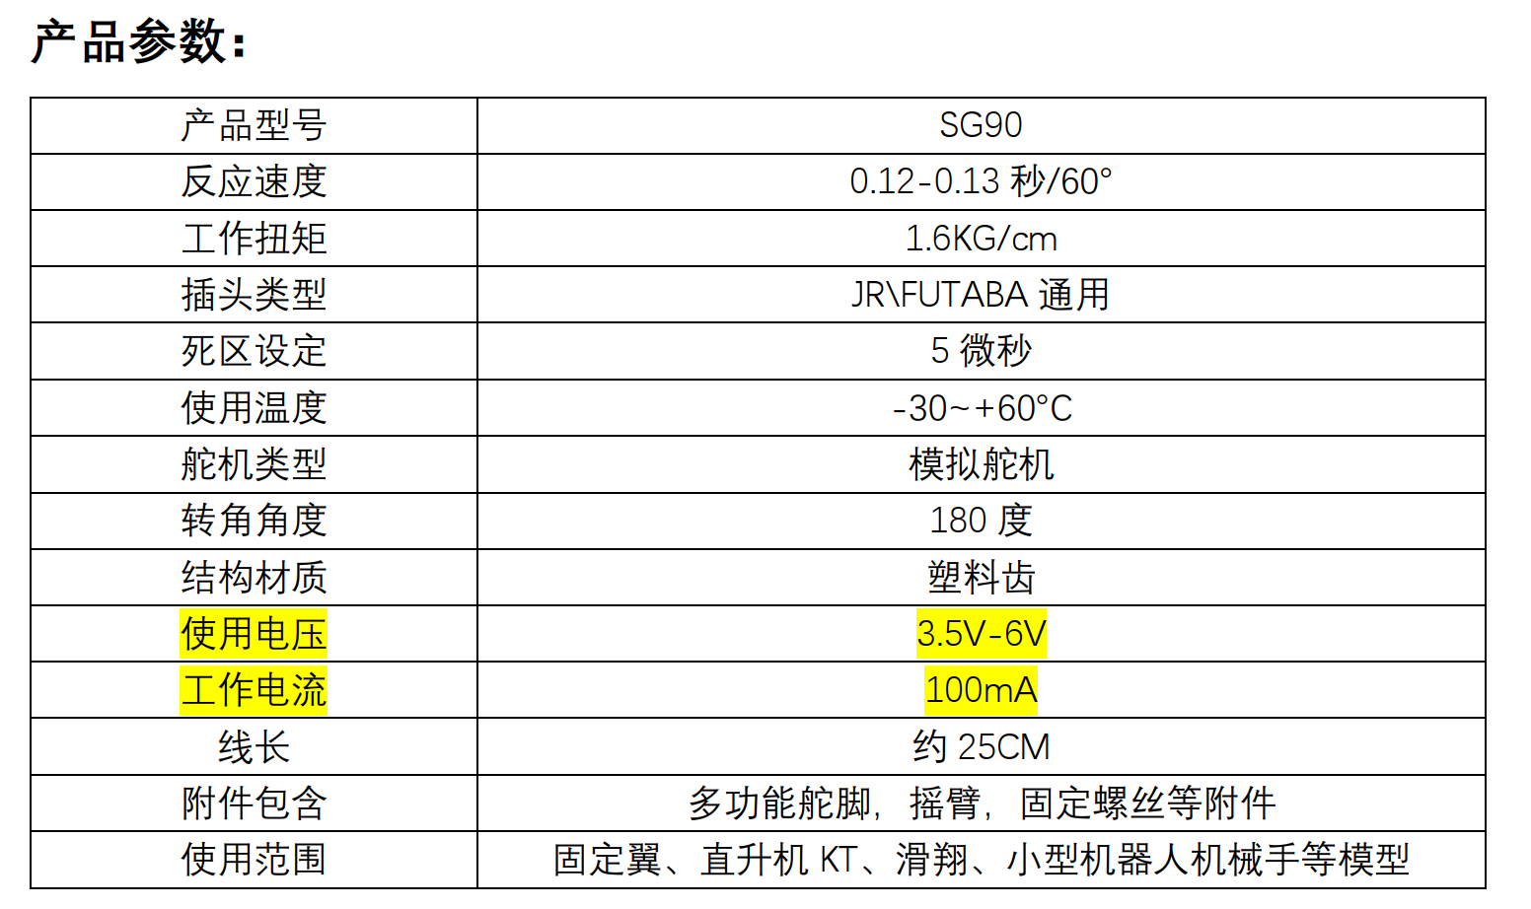
A.2.2.1 Servo Motor I
型号：SG90
电压：3.5-6V (常用5V)
转角角度：180度
质量：9g
淘宝链接

Slide 26
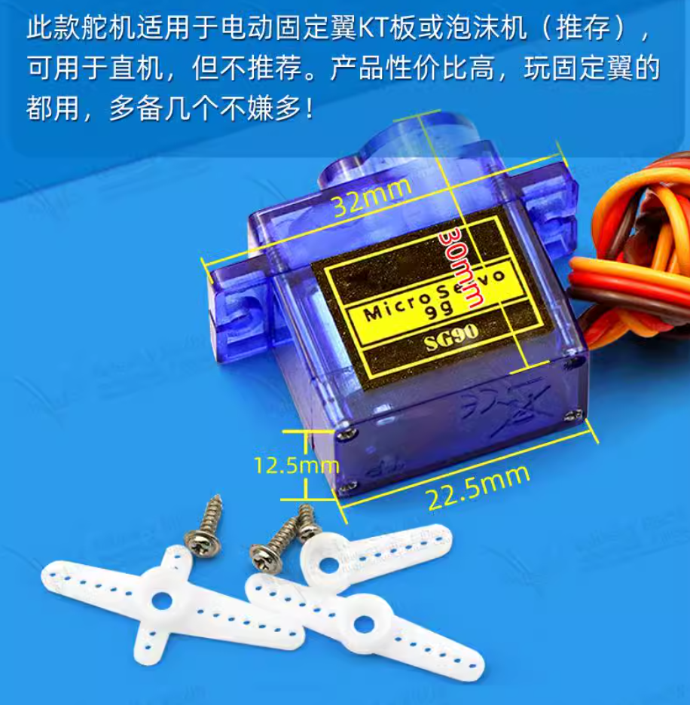
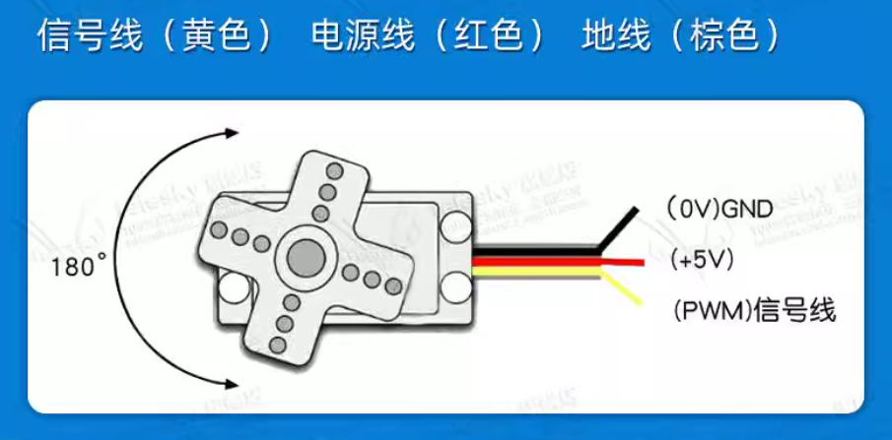
A.2.2.1 Servo Motor I

Slide 27
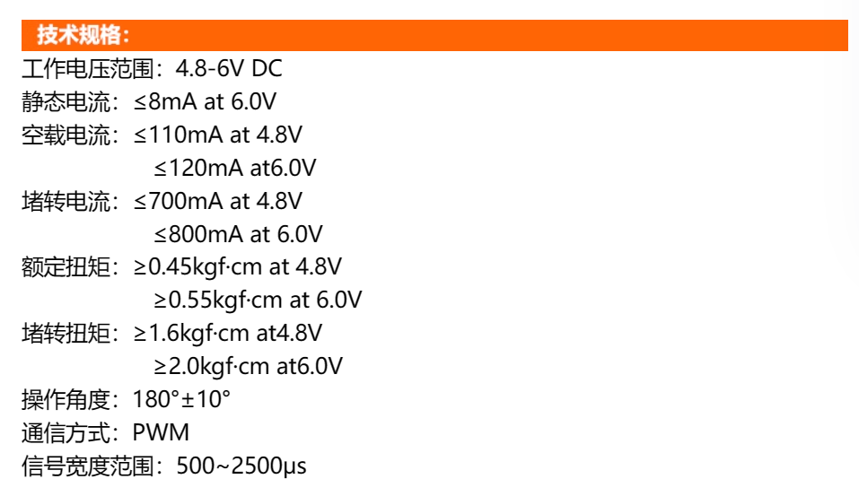
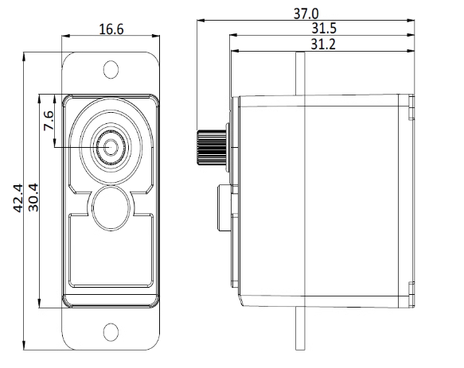
A.2.2.2 Servo Motor II
型号：SER0050
电压：4.8-6V (常用5V)
转角角度：180度
淘宝链接

Slide 28
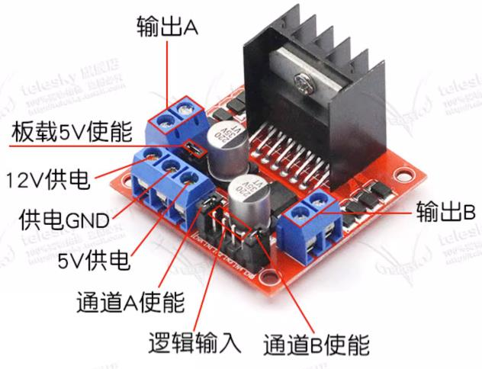
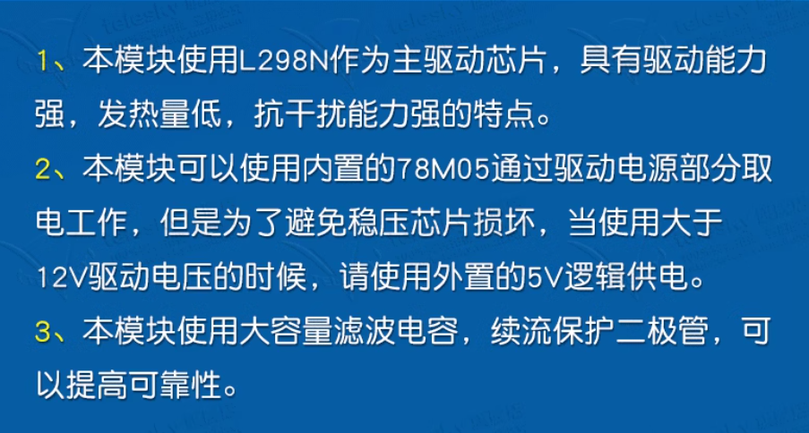
A.2.3 DC Motor Driver Board
型号：L298N
电压：12V & 5V
淘宝链接

Slide 29
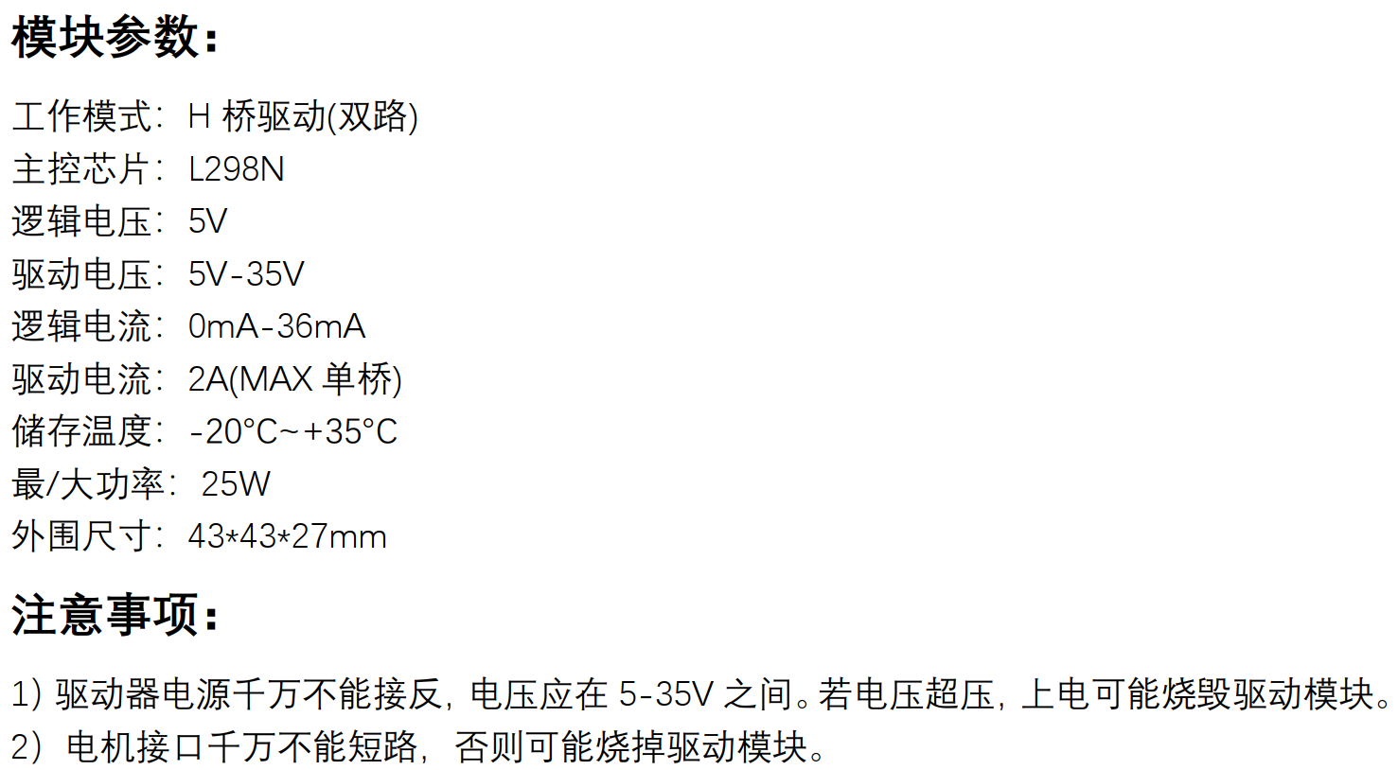
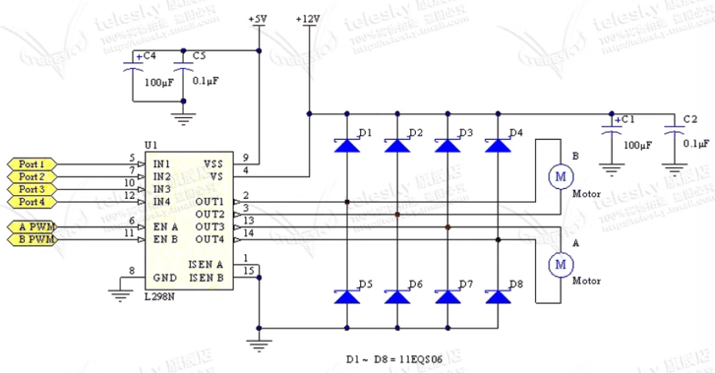
A.2.3 DC Motor Driver Board

Slide 30
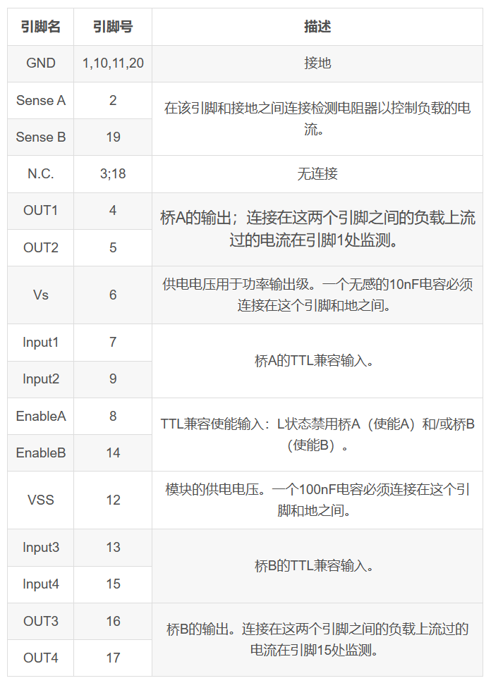
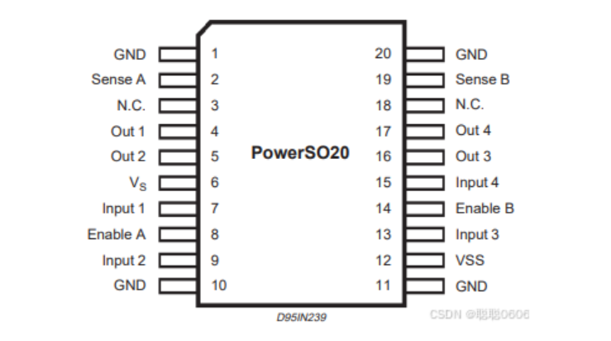
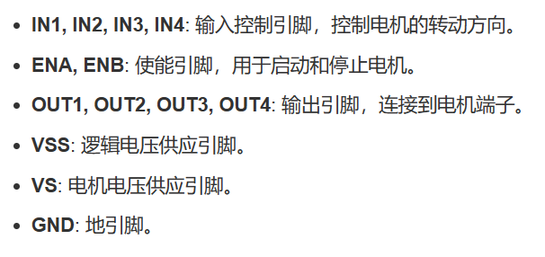
A.2.3 DC Motor Driver Board

Slide 31
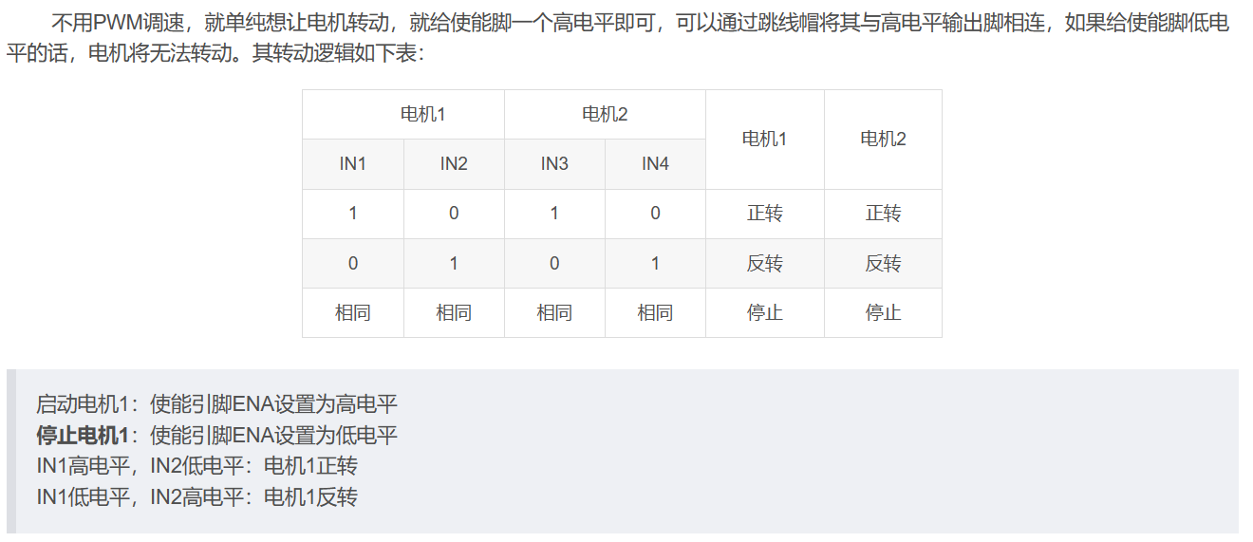
A.2.3 DC Motor Driver Board

Slide 32
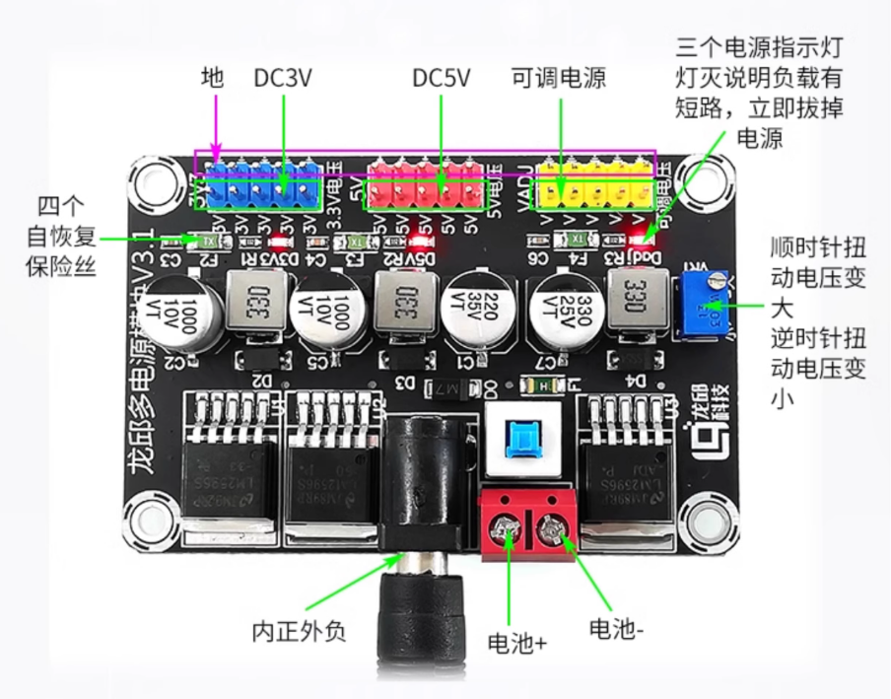
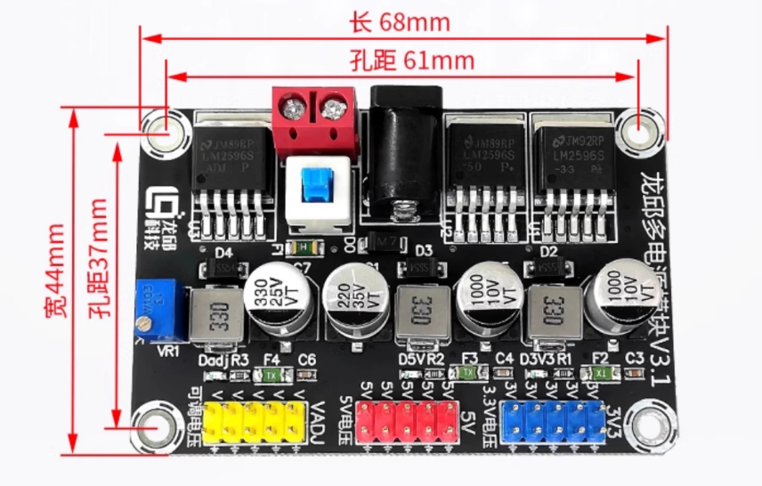
A.2.4 Power Module
型号：LM2596
输入电压：DC 6~25V
输出电压：DC 3.3V，5V，1.25V (每种 x5)
淘宝链接

Slide 33

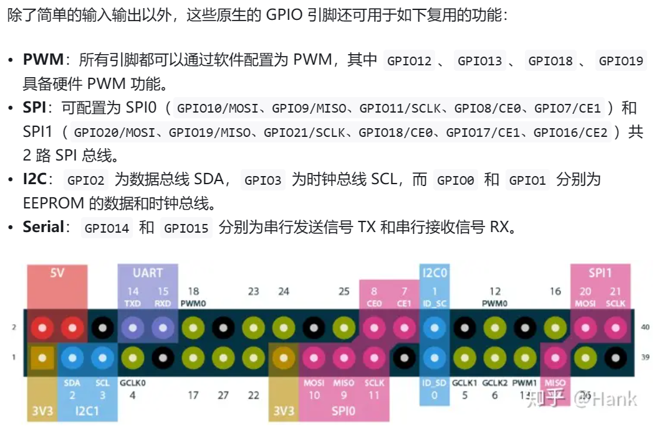
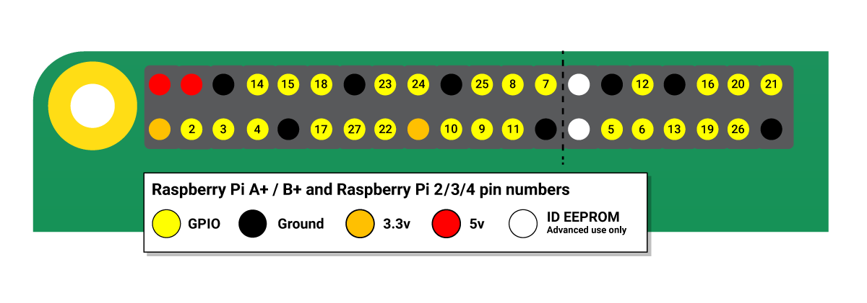
A.2.5 Raspberry Pi 4B
型号：4B
电压：Type C (5V 3A)
淘宝链接
树莓派GPIO
教程参考

Slide 34
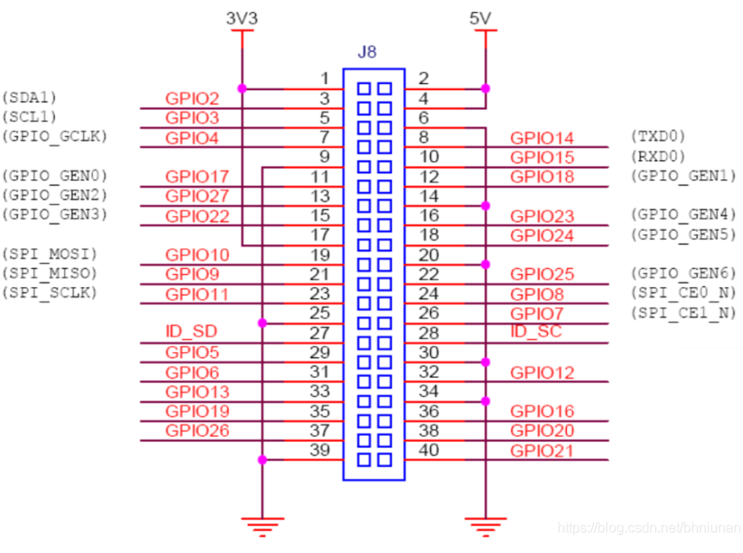
A.2.5 Raspberry Pi 4B

Slide 35
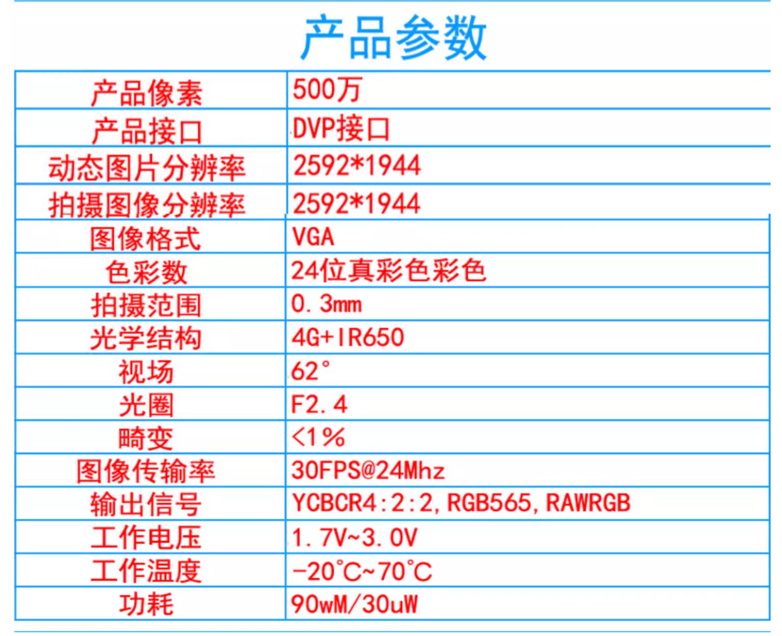
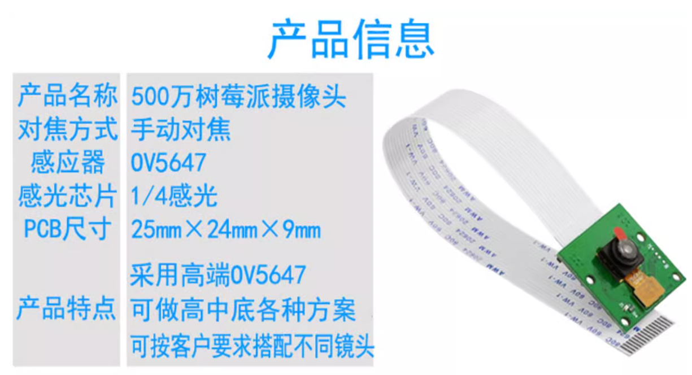
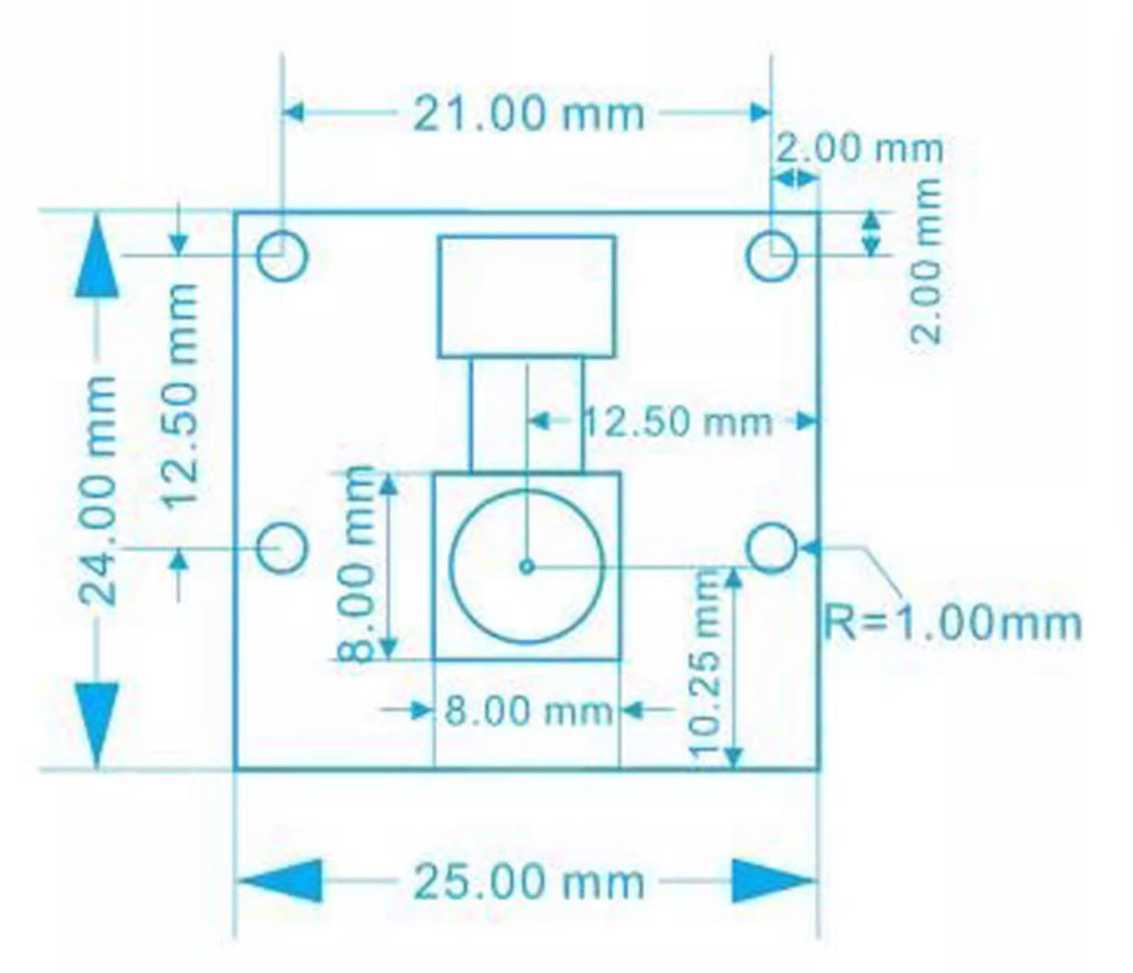
A.2.5.1 Raspberry Pi 4B Camera

Slide 36
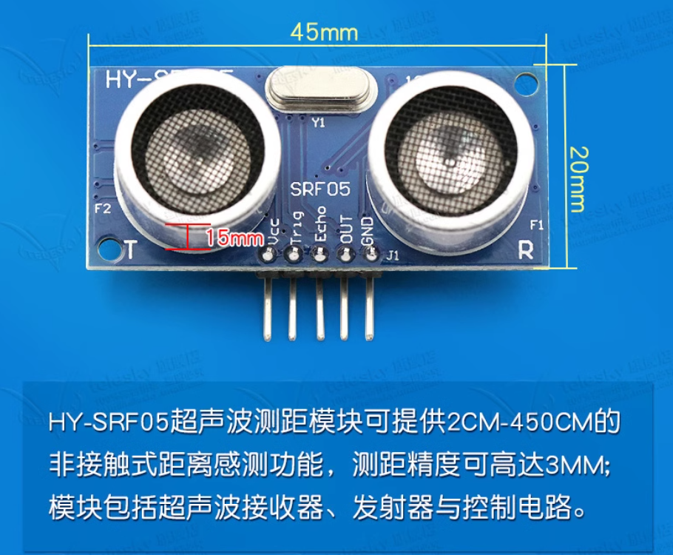
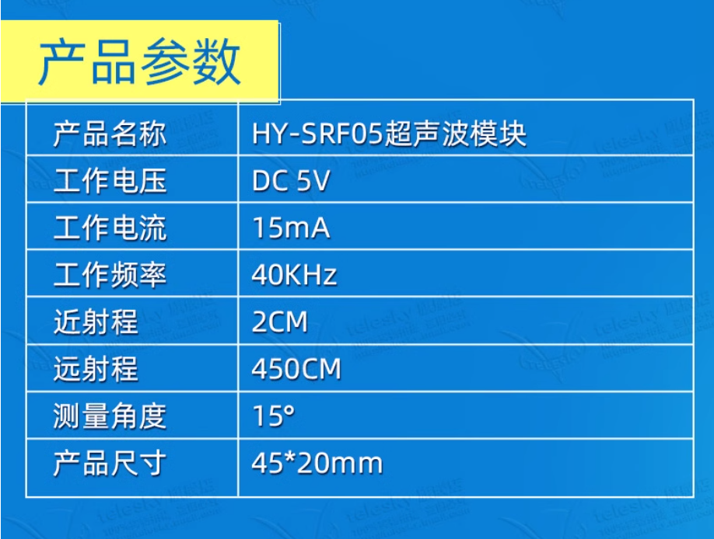
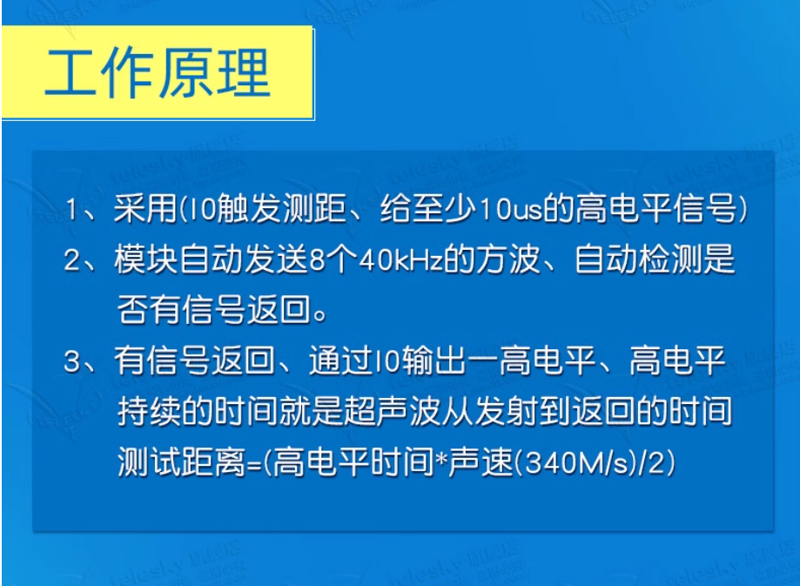
A.2.6 Ultrasonic
型号：HY-SRF05
电压：DC 5V
淘宝链接

Slide 37
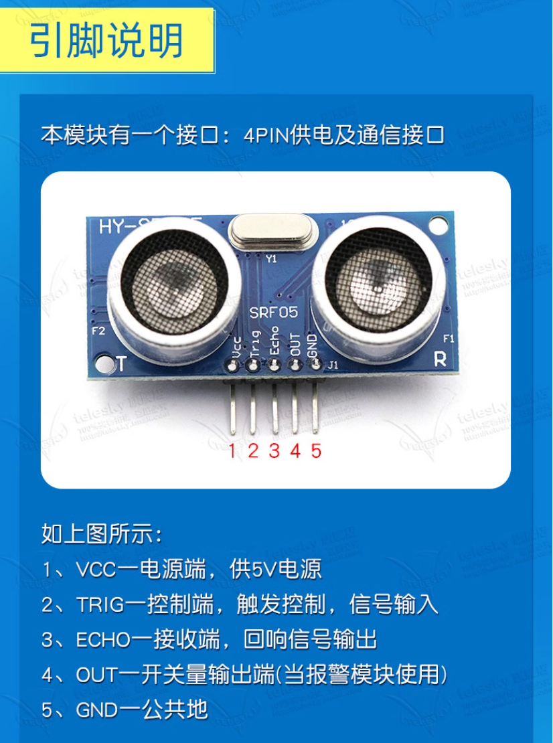
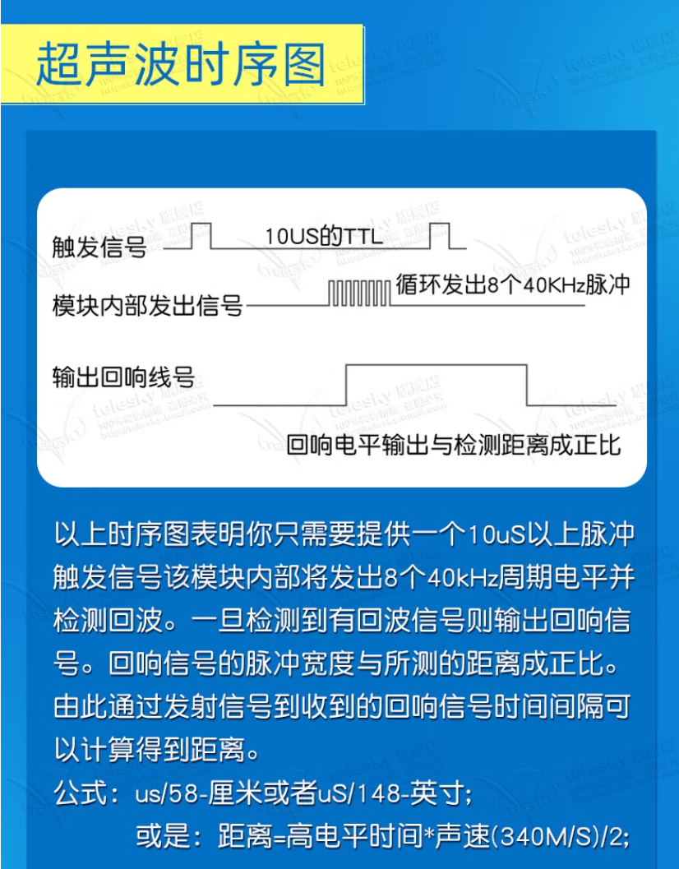
A.2.6 Ultrasonic
ECHO：0~VCC

Slide 38
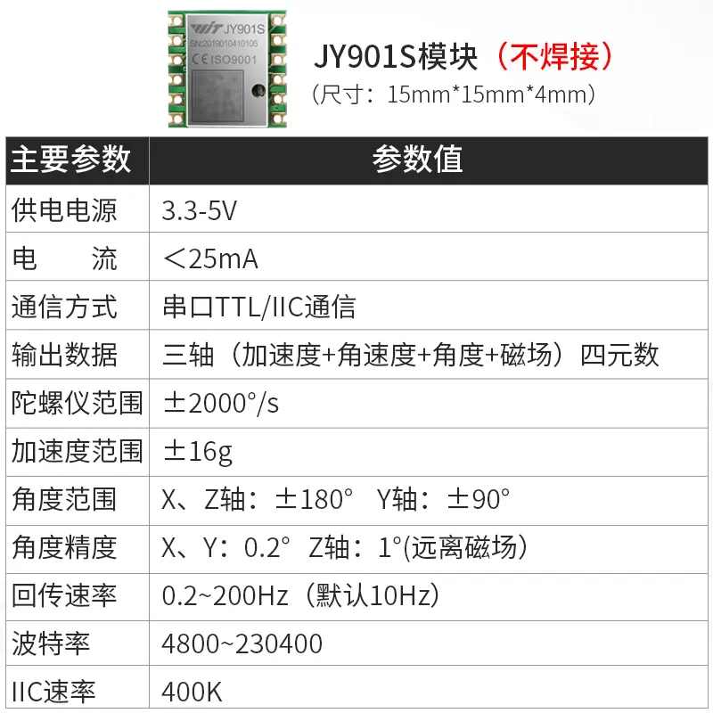
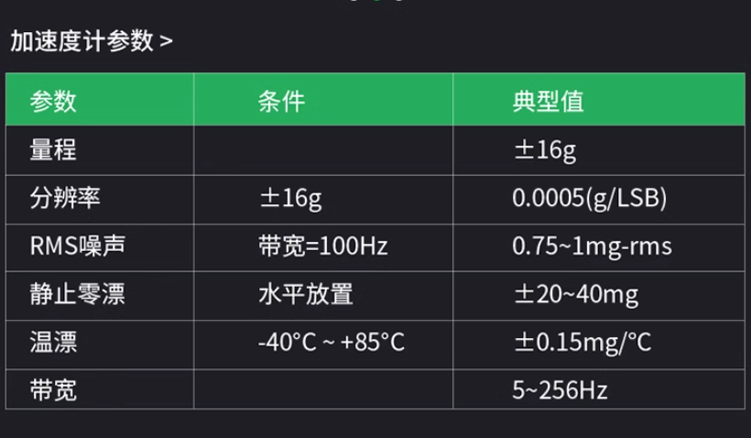
A.2.7 IMU
型号：JY901S
电压：DC 3.3~5V (默认：5V)
淘宝链接

Slide 39
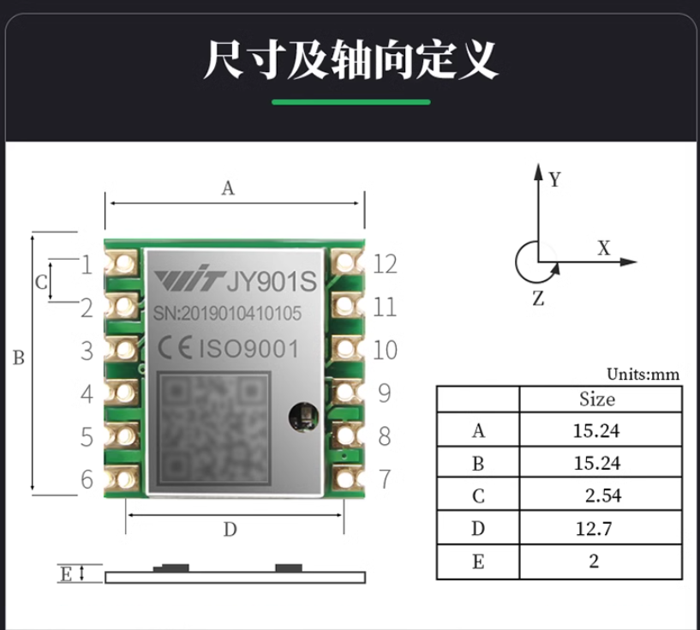
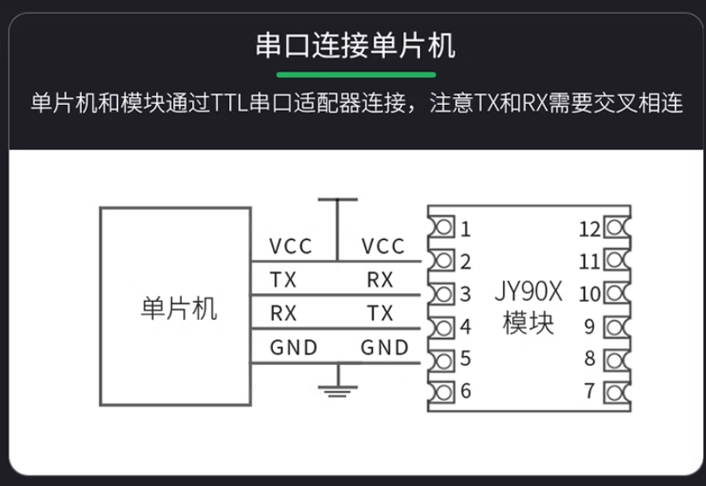
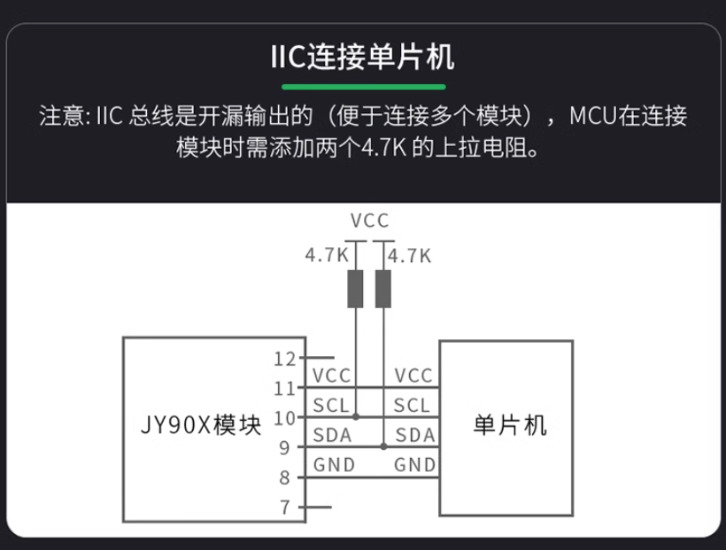
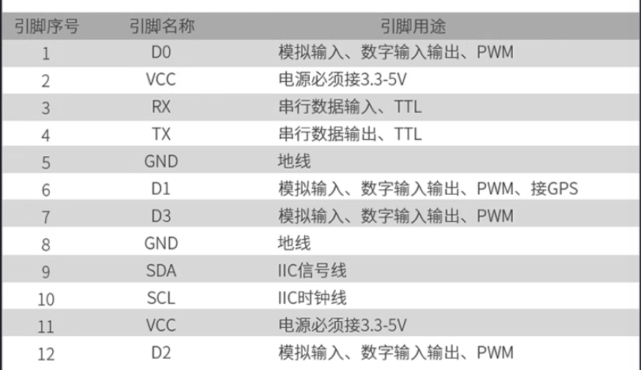
A.2.7 IMU

Slide 40
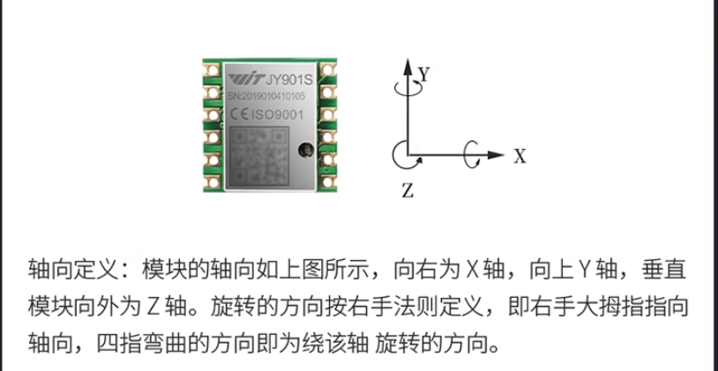
A.2.7 IMU

Slide 41
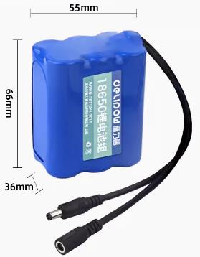
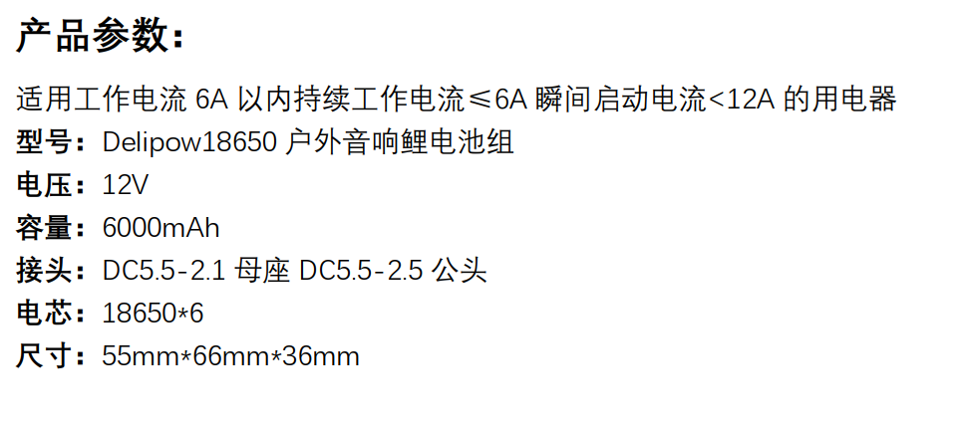
A.2.8 Battery
型号：18650
电压：DC 12V
容量：6000mAh
淘宝链接

Slide 42
A.3 Technical Documentations

Slide 43
A.3.1 Electrical System Schematic
移动电源5V
超声传感器1
HY-SRF05
直流电机左
25GA370
电机驱动模块
L298N
STM32F103VET6
Raspberry Pi
4 Model B
直流电机右
25GA370
电机驱动模块
L298N
直流电机
-旋转刷
加速度传感器
JY901S
舵机
SER0050
电源模块LM2596
超声传感器2
HY-SRF05
12V电源

Slide 44
A.3.1 Electrical System Schematic
5V
HY-SRF05
TRIG
ECHO
25GA370
VCC
GND
Type-C
M2
GND
A
B
3V3
M1
OUT4
ENB
GPIO (PWM) PA8
OUT3
L298N
STM32F103
Pi 4B
IN4
GPIO PE12
GPIO PA3
Type-C
IN3
GPIO PE13
IN2
GPIO PE14
GPIO PC8
IN1
GPIO PE15
ENA
GPIO (PWM) PA9
OUT1
GND
GPIO (PWM) PA10
OUT2
12V
GPIO PE8
25GA370
GPIO PE9
GND
GPIO PA0
A
GPIO PA1
B
GPIO PA6
PB11 RX
TX GPIO 14
3V3
GPIO PA7
PB10 TX
RX GPIO 15
M1
M2
GPIO PB6
GPIO 12 (UART5 TX)
GPIO PB7
GPIO 13 (UART5 RX)
L298N
GPIO (PWM) PC6
GPIO PC7
IN2
GPIO PA2
IN1
TT
ENA
GND
OUT1
GND
GND
OUT2
12V
3V3
A
B
3V3
M1
M2
JY901S
TX
VCC
RX
GND
SER0050
PWM
VCC
GND
LM2596
5V
3V3
GND
GND
HY-SRF05
VCC
GND
TRIG
ECHO
－
＋
12V
－
＋

Slide 45
A.3.1.1 Electrical System Statistics
电气元器件 | 数量
STM32F103VET6 | 1
Raspberry Pi 4 Model B | 1
USB camera | 1
25GA370 DC motor | 2
TT motor | 1
L298N motor driver board | 2
SER0050 servo motor | 1
JY901S IMU | 1
LM2596 power module | 1
lithium battery (12V) | 1
portable charging unit (5V) | 1

Slide 46
A.3.2 Electrical Wiring Table
主控硬件引脚 | 引脚定义 | 元器件 | 元器件引脚
PA8 | TIM1_CH1 | L298N (1) | ENA
PE12 | IO |  | IN1
PE13 | IO |  | IN2
PA9 | TIM1_CH2 |  | ENB
PE14 | IO |  | IN3
PE15 | IO |  | IN4
PA10 | TIM1_CH3 | L298N (2) | ENA
PE8 | IO |  | IN1
PE9 | IO |  | IN2
PA0 | TIM5_CH1 | 25GA370 (1) | Encoder A phase
PA1 | TIM5_CH2 | 25GA370 (1) | Encoder B phase
PA6 | TIM3_CH1 | 25GA370 (2) | Encoder A phase
PA7 | TIM3_CH2 | 25GA370 (2) | Encoder B phase
PB6 | TIM4_CH1 | TT motor | Encoder A phase
PB7 | TIM4_CH2 | TT motor | Encoder B phase

Slide 47
A.3.2 Electrical Wiring Table
主控硬件引脚 | 引脚定义 | 元器件 | 元器件引脚
PC6 | TIM8_CH1 | SER0050 | PWM
GND | / | LM2596 | GND
VIN | 5V input | LM2596 | 5V
PC7 | TIM8_CH2 | HY-SRF05 (1) | ECHO
PA2 | TIM2_CH3 |  | TRIG
PC8 | TIM8_CH3 | HY-SRF05 (2) | ECHO
PA3 | TIM2_CH4 |  | TRIG
PB11 | USART3_RX | Raspberry Pi 4 Model B | 8 (GPIO 14 TXD)
PB10 | USART3_TX |  | 10 (GPIO 15 RXD)
Above: STM32F103VET6
Below: Raspberry Pi 4 Model B
32 | GPIO 12 (UART5_TX) | JY901S | RX
33 | GPIO 13 (UART5_RX) | JY901S | TX
Type-C | / | Battery | Type-C

Slide 48
A.3.2 Electrical Wiring Table
元器件 | 元器件引脚 | 元器件 | 元器件引脚
L298N (1) | OUT1 | 25GA370 (1) | M1
L298N (1) | OUT2 | 25GA370 (1) | M2
L298N (1) | OUT3 | 25GA370 (2) | M1
L298N (1) | OUT4 | 25GA370 (2) | M2
L298N (2) | OUT1 | TT motor | M1
L298N (2) | OUT2 | TT motor | M2
Above: motor driver
Below: power supply
STM32F103VET6 | 3V3 | LM2596 | 3V3
TT motor
25GA370 (1)
25GA370 (2)
HY-SRF05 (1) | 5V |  | 5V
HY-SRF05 (2)
JY901S

Slide 49
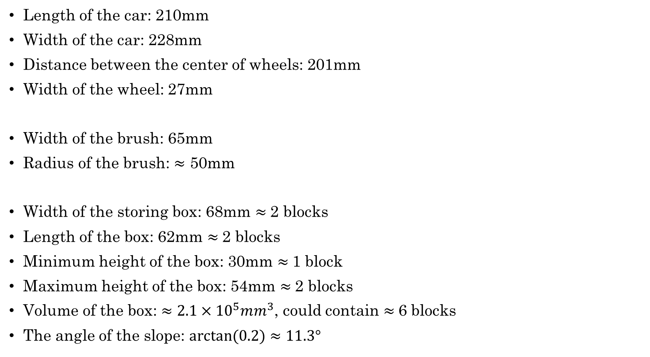
A.3.3 Parameters of the car
Length of the car: 210mm
Width of the car: 228mm
Distance between the center of wheels: 201mm
Width of the wheel: 27mm
Width of the brush: 65mm
Radius of the brush: $≈$ 50mm
Width of the storing box: 68mm $≈$2 blocks
Length of the box: 62mm $≈$2 blocks
Minimum height of the box: 30mm $≈$1 block
Maximum height of the box: 54mm $≈$2 blocks
Volume of the box: $≈2.1×{10}^{5}mm^{3}$, could contain $≈$6 blocks
The angle of the slope: $arctan⁡(0.2)≈11.3°$

Slide 50
A.3.4 Control Flow Chart
程序初始化
主循环While(1)
读取传感器数据
模块
执行
运动控制
目标识别与定位
向PC发送
状态信息
向上位机发送
状态信息
读取上位机指令

Slide 51
A.3.5 Control Module Division
模块 | 上位硬件模块输入 | 子模块 | 功能说明
目标识别 | 相机 | 物体识别 | 通过图像确定目标物体
 | 摄像头，超声波传感器 | 避障测量 | 确定目标物体距离
运动控制 | 电机编码器 IMU | 电机转速控制 | 利用PWM控制电机转速
 |  | PID闭环控制 | 根据采样数据精确控制电机运动
信号传输 | / | 串口通讯 | 模块间通讯
 |  | WIFI通讯 | 树莓派与PC间通讯

